Slide 1

Hotel Booking status prediction

Slide 2
CONTEXT
Problem statement
Visualization
Procedure
Models
Suitable choice of the Models
Conclusion

Slide 3
1)Problem statement:
In addition to some additional criteria that were included in our data set, this issue statement discusses the hostel status, which basically displays how many people are cancelling their bookings at various locations.
Now we must analyse the supplied data and develop a classification model.
The Link of the data set is :https://raw.githubusercontent.com/Premalatha-success/Datasets/main/hotel_bookings.csv

Slide 4
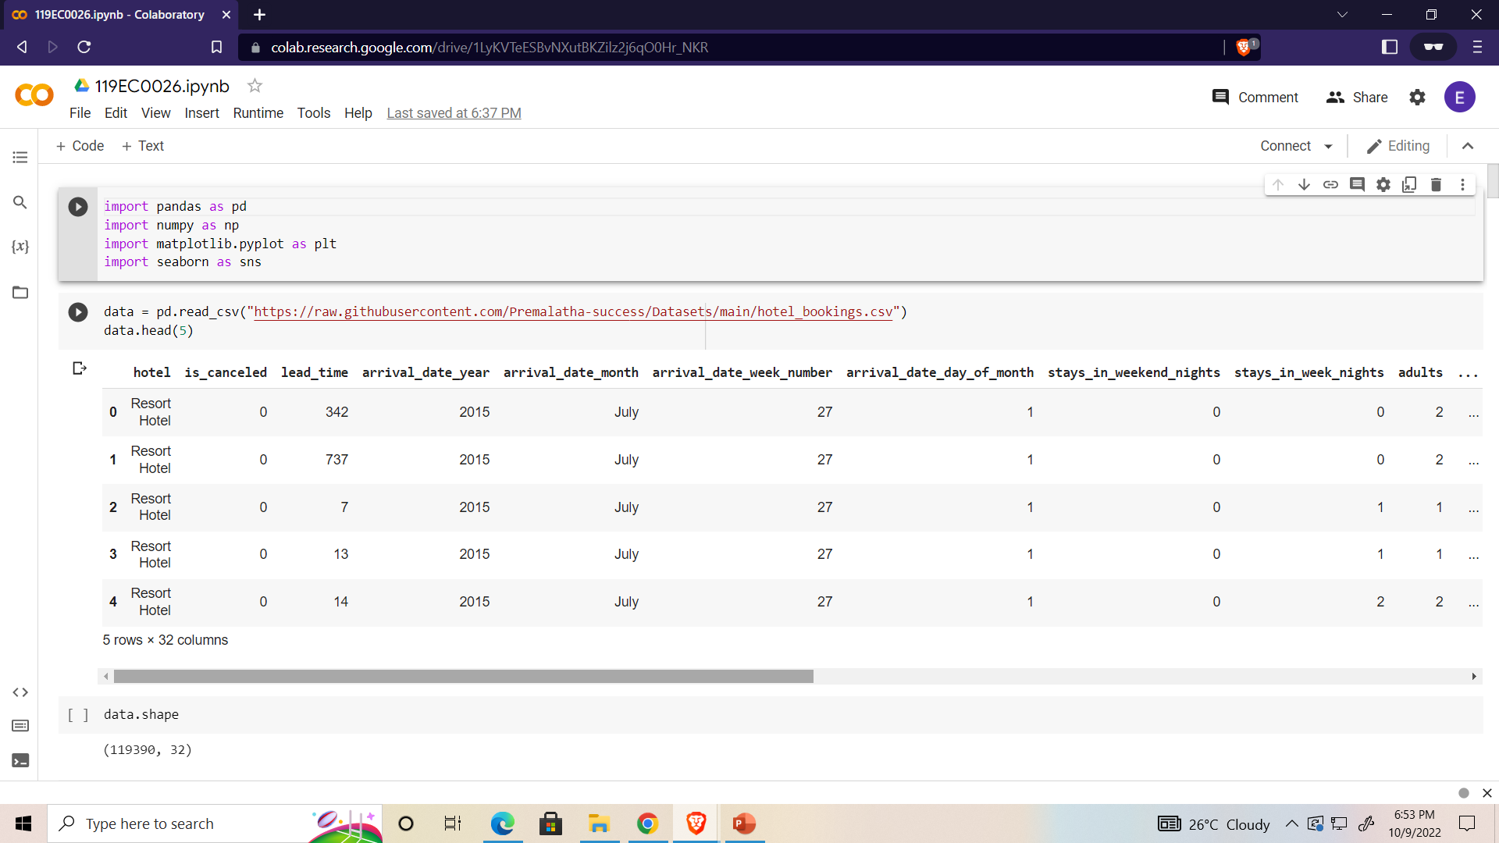
Data SET:-

Slide 5
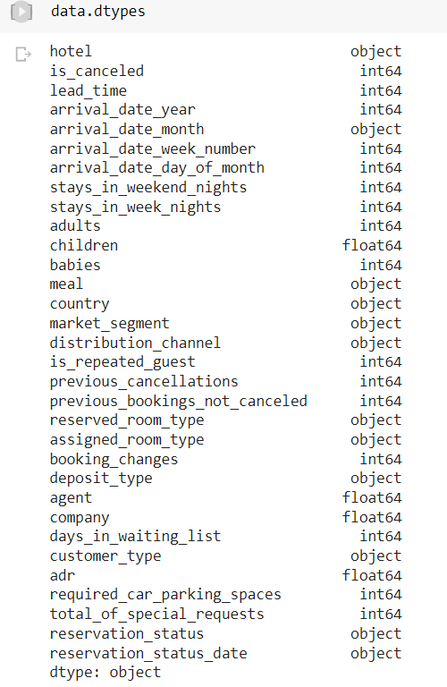
Data Discussion
Formatting the data set

Slide 6
2)Visualization.

Slide 7
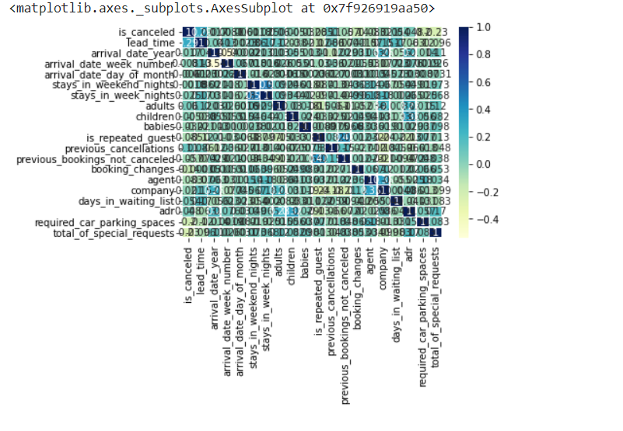
Correlation of the given data set

Slide 8
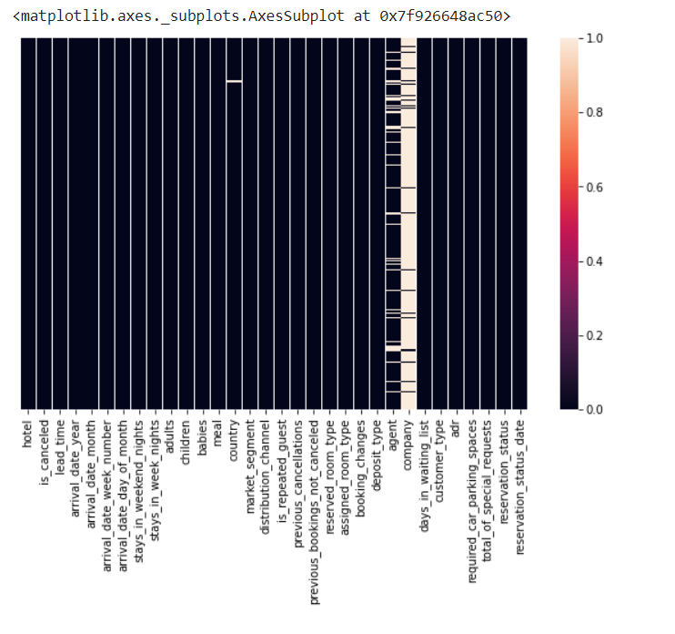
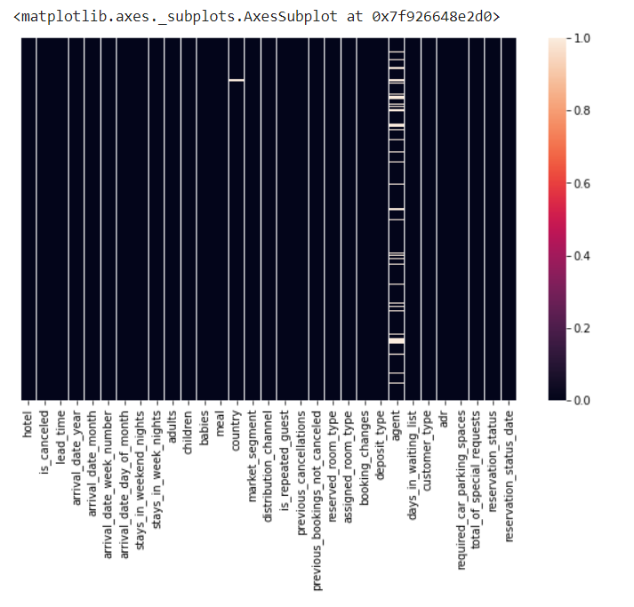
heat map:
Before
After

Slide 9
3)Procedure
Here I had 4 steps to do this project
Step 1 Import the packages numpy,pandas, matplotlib,seaborn,sklearn,train test split,metrics
Step 2:Load the Dataset
Step 3:Explore the data-shape,visualisation
Step 4:X,y—>train data test data->Fit the model with training data predict with the test data

Slide 10
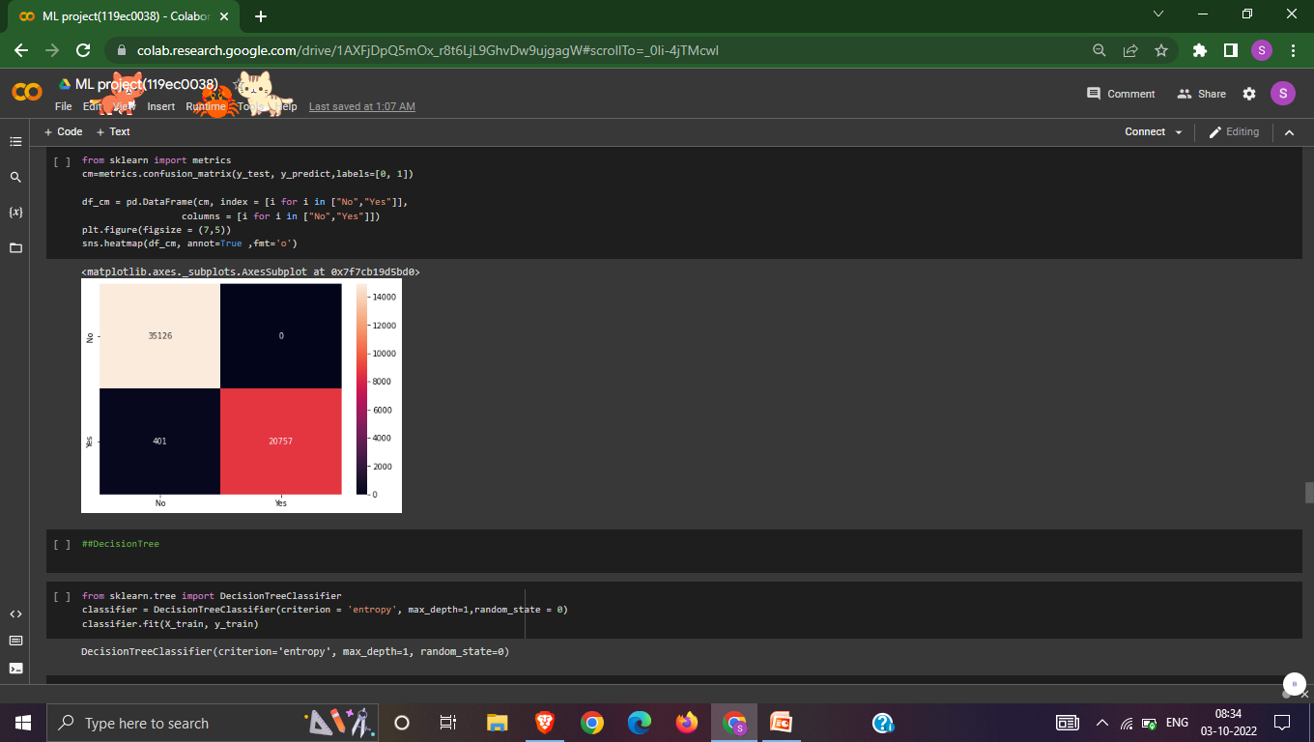

4)ModeLs
logistic regression
DecisionTree

Slide 11
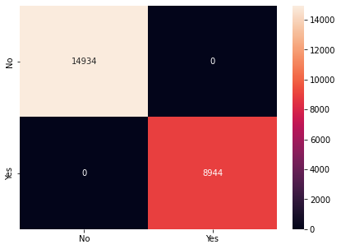
Bagging
AdaBoost

Slide 12
Gradient Boosting Classifier

Slide 13
5)suitable choice of the Models
I experimented with all five of the categorised ML algorithms, but in the end I settled on the Gradient Boosting classifier because it runs quickly, has a 100% accuracy rate, and has no confusion matrices (Q1 and Q3).
It is based on the hypothesis that the overall prediction error is minimised when past models are combined with the best viable upcoming model.

Slide 14
6) Conclusion
Following the visualisation of features in the data set using training and testing data.
For logistic regression
Training:0.990053605829634
Testing: 0.9892369545188039

Slide 15
DecisionTree
Training:0.990053605829634
Testing:0.9892369545188039

Slide 16
Random Forest
Training: 0.9999895301113996
Testing: 0.9997487226735907
Bagging
Training:1.0
Testing:1.0

Slide 17
Ada Boosting
Training:1.0
Testing:1.0
Gradient Boosting
Training:1.0
Testing:1.0

Slide 18
Thankyou
By:
Joseph Srujan Eda
119EC0026

